Slide 1
FINGERPRINT DOOR LOCK USING ARDUINO
-BY AKHIL SAHUKARU (19BCY10015) & HEMANT PRATAP SINGH (19BCY10068)
PROJECT GUIDE – DR. PRAVEEN LALWANI

Slide 2
Abstract
We have tried to apply the concept of security in real life by the collaborative use of electronic materials, hardware and software
In this project we will be making a secured door lock, using Arduino IDE, which works on biometric scanning
Biometric scanning is the most trusted for all security systems nowadays
The project includes coding (in Arduino software), hardware assembly of all the materials for the working model

Slide 3
WORKING OF MODEL
Fingerprint sensor is interfaced with the Arduino Uno. We have to enroll the fingerprint to the fingerprint sensor.
It saves your fingerprint data and makes patterns inside the memory.
The shape of the patterns are converted into binary codes by Arduino.
It will save different patterns and codes for each fingerprint.
The data is compared with the every finger scanned on the scanner.

Slide 4
MATERIALS REQUIRED
Adafruit Fingerprint Scanner
Arduino Uno R3
12V Electronic Door Lock
5V Relay Module
12c LCD
7V – 12V Power Supply
Jumper Wires

Slide 5
HARDWARE & SOFTWARE REQUIREMENTS
HARDWARE REQUIREMENTS :
Relay module
Arduino Uno R3
Solenoid Lock
Jumper Wires
Adafruit Fingerprint Scanner
SOFTWARE REQUIREMENTS :
Arduino IDE

Slide 6
CIRCUIT DIAGRAM/System architecture

Slide 7
working
Relay Module - The relay module is a separate hardware device used for remote device switching. Devices can be remotely powered on or off with commands coming from the Arduino Uno board
There is one input for the relay module and one for voltage
One goes to the connection of ground (as to neutralize it)
Arduino Uno Board –
There are 2 inputs to the board (of the fingerprint scanner)
There is 1 input which gives power to the board
1 goes to ground (as to neutralize it)

Slide 8
REAL TIME USE
The fingerprint door look can actually be used in real life
The lock can be placed inside the door with a hatch
The fingerprint scanner can be placed outside the door
Once the fingerprint matches and is recognized the lock may open from inside

Slide 9
EXISTING WORK
We have gathered the material
The libraries for the fingerprint sensor have been downloaded on Arduino
Link for the library - https://github.com/adafruit/Adafruit-Fingerprint-Sensor-Library
Zip file -

Slide 10
PROPOSED WORK
Assembly of all the elements of the model
Registering of fingerprints by using the given libraries
Writing the whole code on Arduino
Test and evaluate the first prototype
Execution and go live of the prototype

Slide 11
IMPLEMENTATION AND CODING
There are two codes we have to upload in our Arduino UNO microprocessor board through Arduino IDE software
Finger print Enrollment Code : This code is for the enrollment of our fingerprints with the help of the existing libraries
Fingerprint Lock Code : This code will run in loops ie. only if the fingerprint matches then the lock will open
This code will take into consideration all the other components of the model

Slide 12
IMPLEMENTATION AND CODING
The codes are attached below in a .rar file

Slide 13
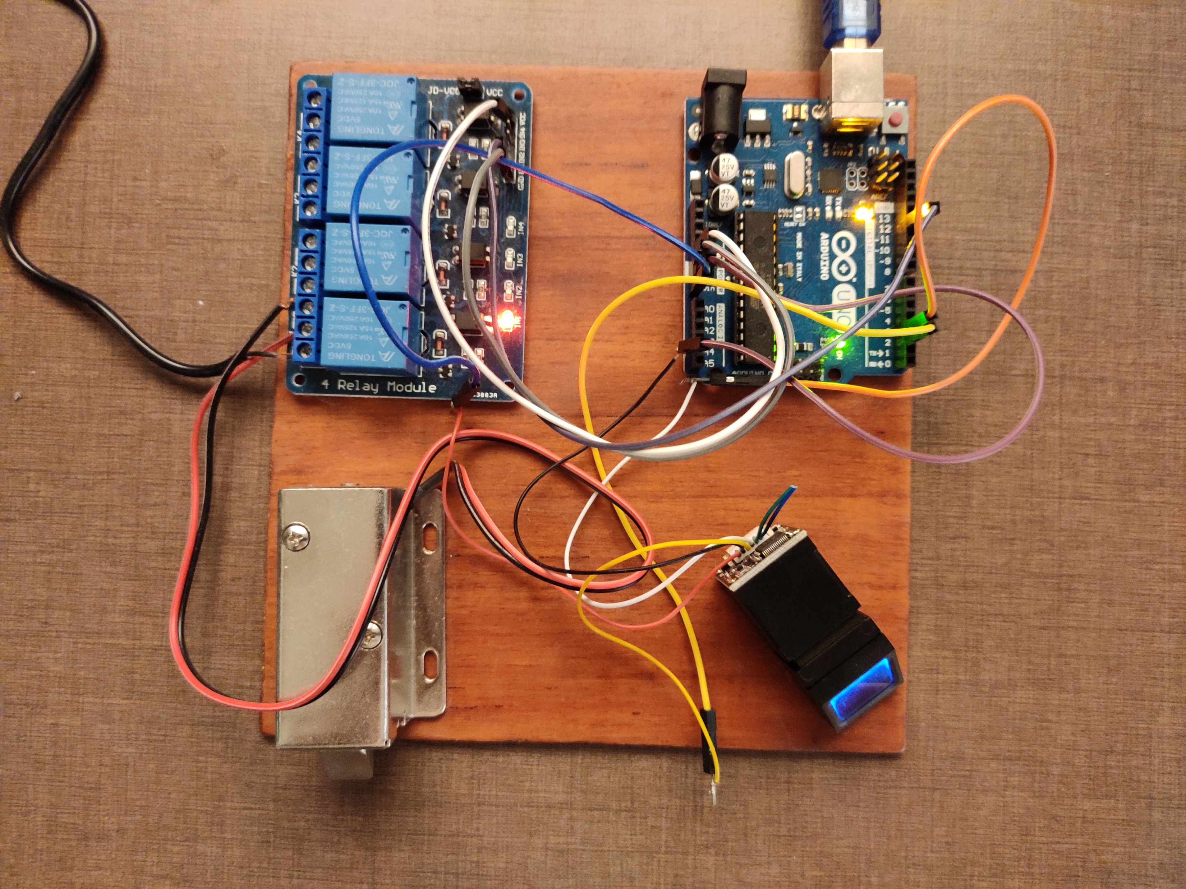
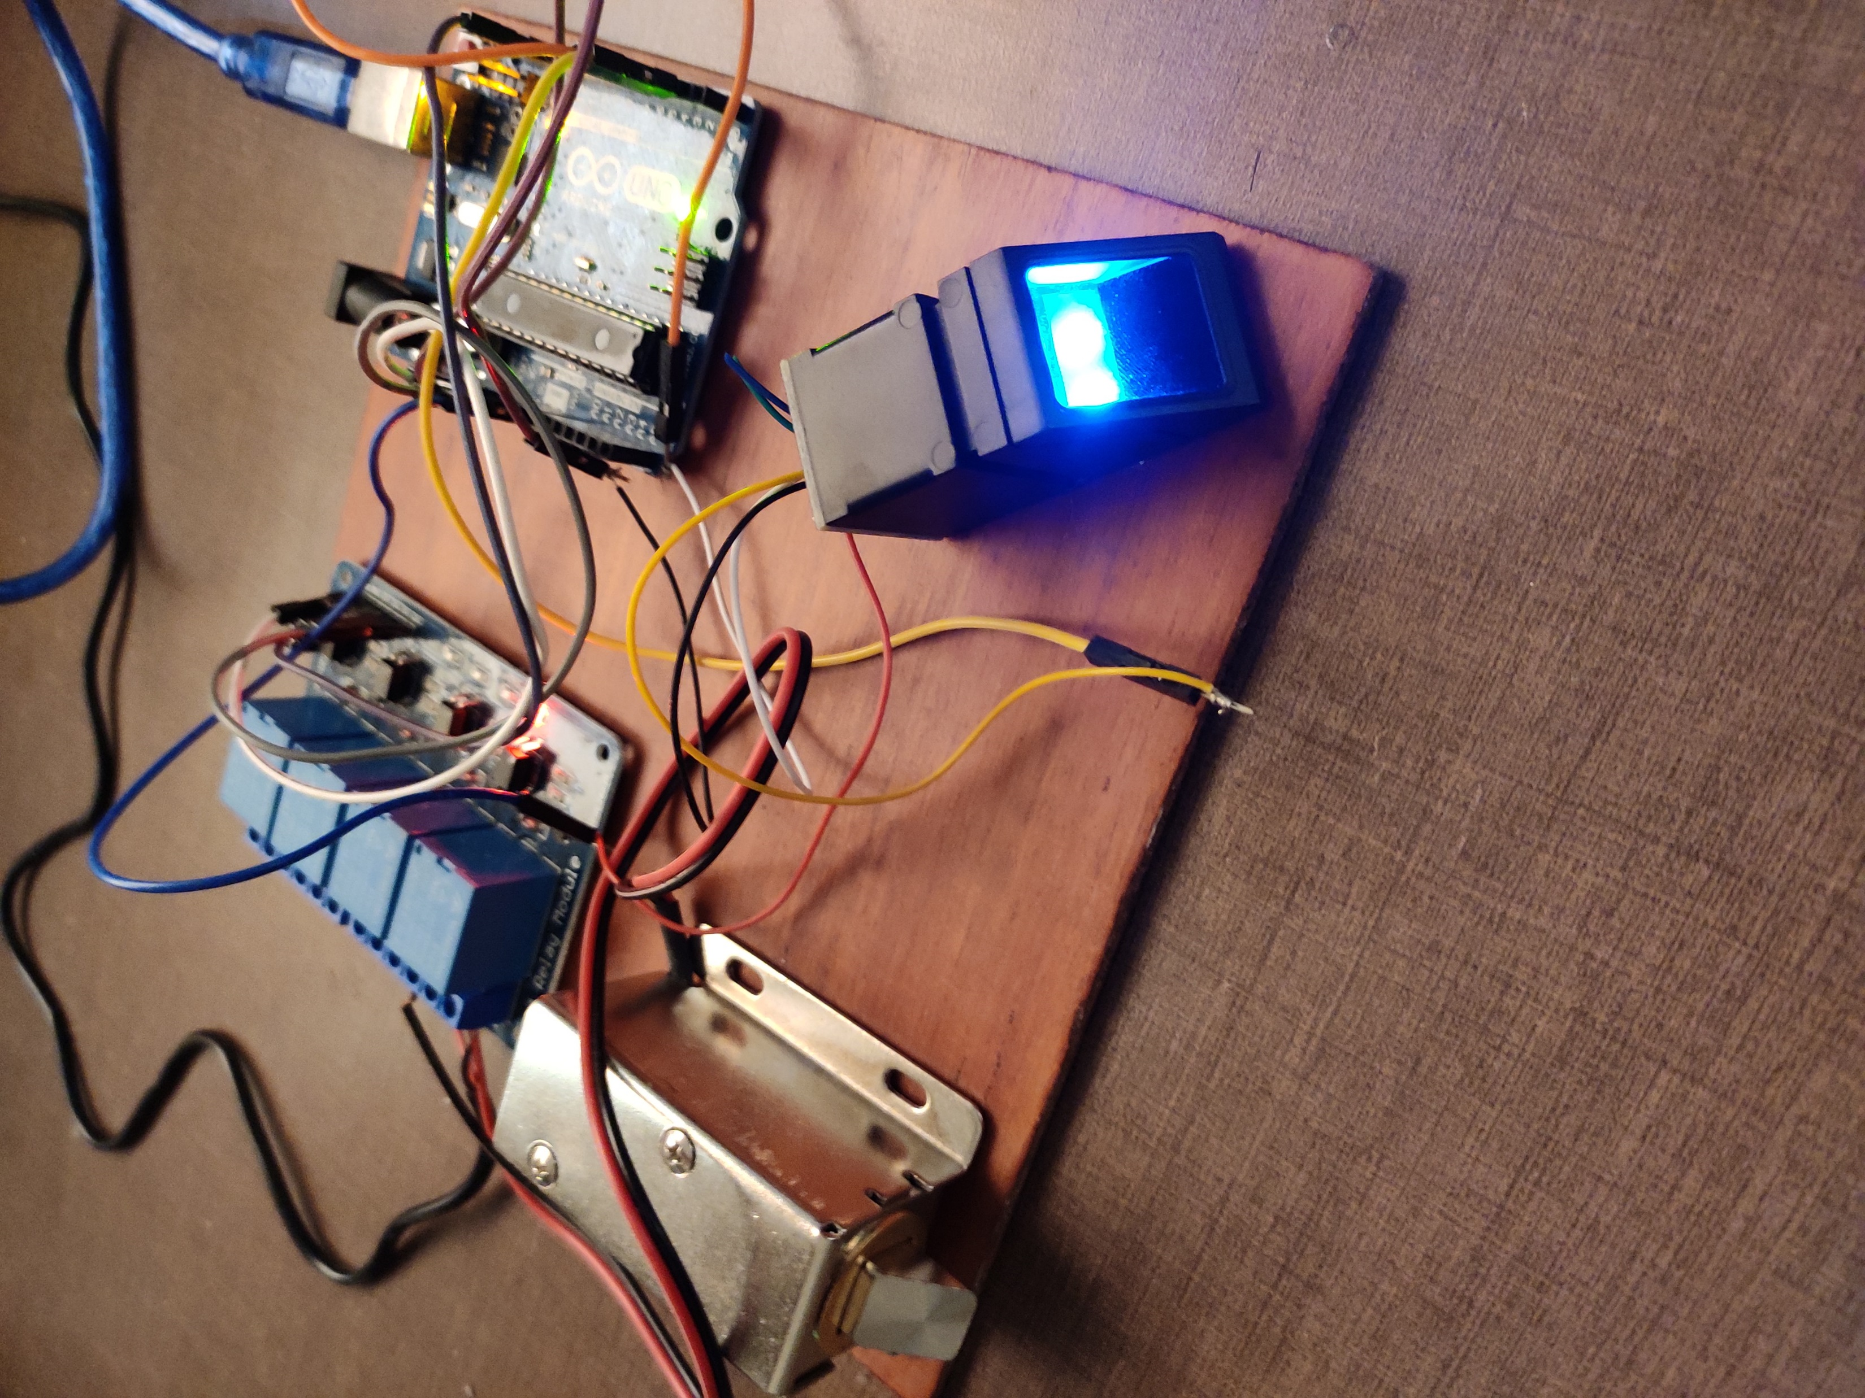
FINAL MODEL SNAPSHOT

Slide 14
TESTING
We tested the whole model
It worked perfectly without any issues

Slide 15
RESULT
Once the fingerprint (which is stored/enrolled in the scanner) matches the fingerprint which is being scanned the lock successfully opens
If the fingerprint does not match the one which is enrolled the lock does not open
In this way we were successfully able to make a fingerprint door lock

Slide 16
NOVELTY OF WORK
We took references of a few previous projects on the same topic
It is a collaboration between digital forensic and electronics
We selected this project because it is very different from the usual ones
The knowledge, coding, execution is all done by us
The results and outcome will be discussed after completion of the project

Slide 17
CONCLUSION
Through this project we were able to establish a good connection between digital forensic and the day to day life of people
We could study the concept of cryptography, in fingerprint’s storage and detection
Use of Arduino IDE for programming and Arduino UNO as a microcontroller
Successfully made a real fingerprint door lock

Slide 18
REFERENCES
https://www.youtube.com/watch?v=SMmj_qAbyeM
https://maker.pro/arduino/projects/how-to-create-a-fingerprint-reading-door-lock-system-with-an-arduino-uno
https://www.electronoobs.com/eng_arduino_tut41.php
https://www.youtube.com/watch?v=4iklgEtV9to

